Slide 1
NAT Traversal
ICE, STUN, and TURN

Slide 2
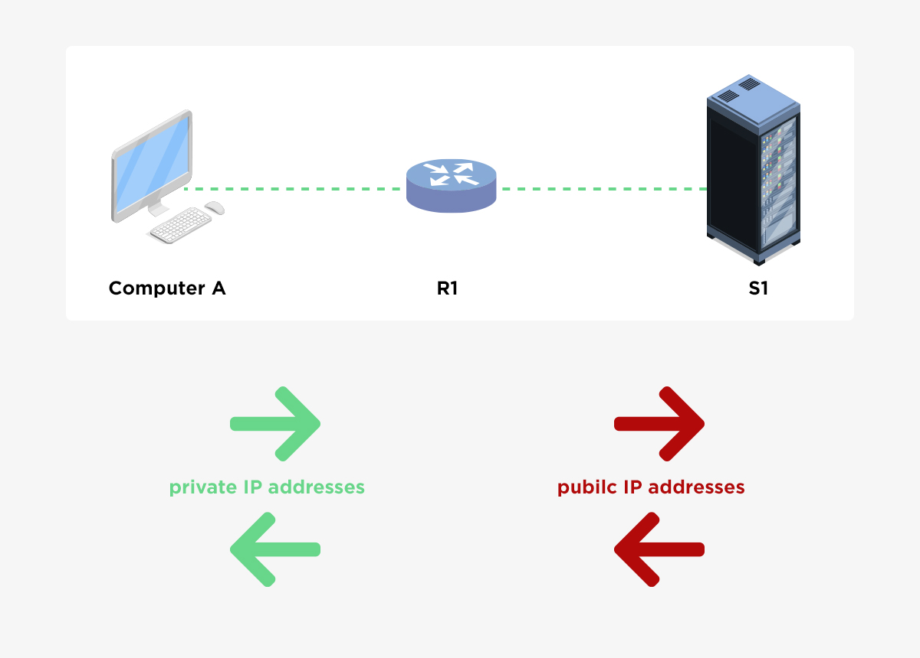
What is NAT?
Network Address Translation
Moving an address from one address space to another
Common example: one-to-many NAT
Routers translate between many private IP addresses and it’s one public IP

Slide 3
Why use NAT?
NAT Helps reuse IP addresses during the transition to IPv6
Private IP addresses don’t need to be unique, only public ones
If the public IP changes, all the private connections are still the same

Slide 4
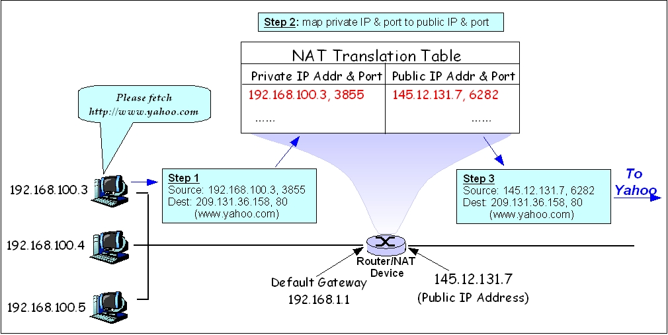
NAT Translation Tables
Table to map 1 address and port to another address and port
Traffic to private devices is assigned its own public port

Slide 5
NAT Firewall
Controls which connections are allowed through a NAT.
If no mapping exists in the NAT translation table, the packet can also be discarded.

Slide 6
Types of NAT
Full-cone
Address-restricted
Port-restricted
Symmetric

Slide 7
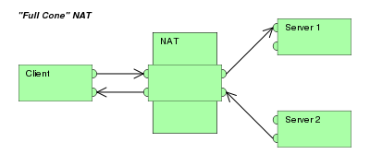
Full Cone NAT
One private address and port is mapped to one port on the NAT device
Any address can communicate with the private client through the external address and port

Slide 8

Address-restricted Cone NAT
Usually called just “restricted cone NAT”
One private address and port is mapped to one port on the NAT device
External communication is only allowed if the private client has previously sent a message to the IP address on any port.

Slide 9

Port-restricted Cone NAT
One private address and port is mapped to one port on the NAT device
External communication is only allowed if the private client has previously sent a message to the IP address on the same port.

Slide 10
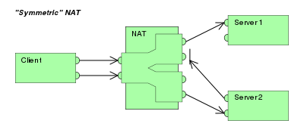
Symmetric NAT
One private address and port is mapped to one port on the NAT device
External communication is only allowed if the private client has previously sent a message to the IP address on the same port.

Slide 11
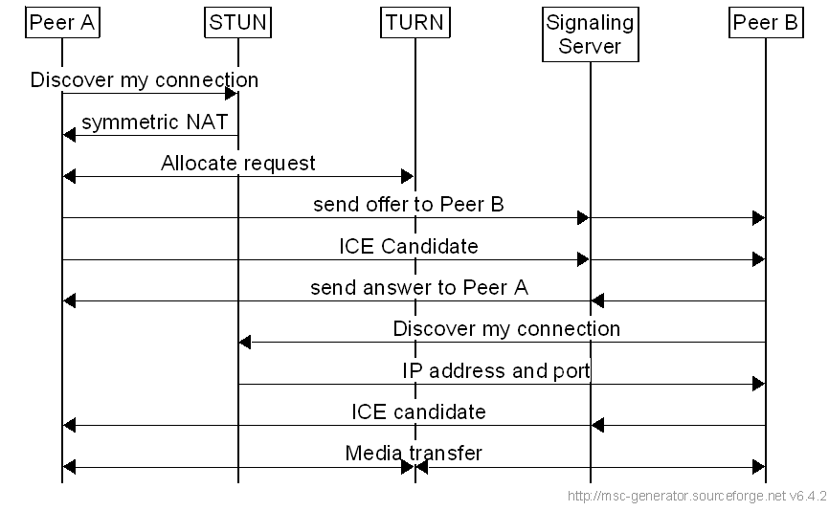
ICE
How can two peers behind NAT communicate directly?
The ICE protocol determines the most direct method of communication between peers.
Two protocols: STUN and TURN

Slide 12
STUN
Session Traversal Utilities for NAT
STUN detects the NAT and discovers the public IP addresses.
Peers connect to a public server which provides them with the address and port needed for direct communication.
Does not work with symmetric NAT
Changing the destination adds a new entry to translation table.

Slide 13
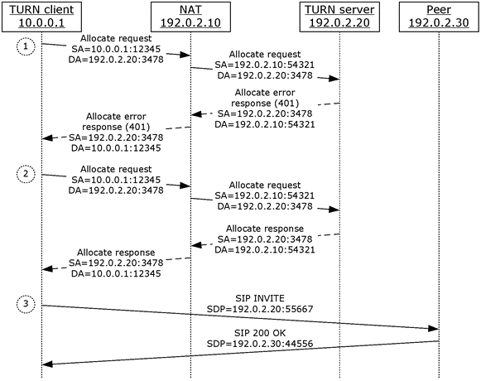
TURN
Traversal Using Relays around NAT
All communication is passed through a public relay server
Expensive for server owner, so less preferable
Works on symmetric NAT

Slide 14
UDP Hole Punching
In full cone, restricted cone, and port-restricted cone NAT, traffic is allowed if the peer initiates it.
Use STUN server to determine public IP and port, then send messages to each other.
Peers punch a hole through the NAT and connect directly

Slide 15
UDP Hole Punching
Private IP / Port | Public IP / Port | Destination
192.168.0.123:12345 | 42.133.44.118:54321 | STUN Server
Peer A
Private IP / Port | Public IP / Port | Destination
192.168.0.143:54423 | 72.24.151.188:33241 | STUN Server
Peer B
Clients connect to STUN server, which gives them their public IP / port.

Slide 16
UDP Hole Punching
Private IP / Port | Public IP / Port | Destination
192.168.0.123:12345 | 42.133.44.118:54321 | 72.24.151.188:33241
Peer A
Private IP / Port | Public IP / Port | Destination
192.168.0.143:54423 | 72.24.151.188:33241 | 42.133.44.118:54321
Peer B
Clients send a connect message to each other.

Slide 17
UDP Hole Punching
Private IP / Port | Public IP / Port | Destination
192.168.0.123:12345 | 42.133.44.118:54321 | 72.24.151.188:33241
Peer A
Private IP / Port | Public IP / Port | Destination
192.168.0.143:54423 | 72.24.151.188:33241 | 42.133.44.118:54321
Peer B
When a message is received, check if the receiver initiated communication. If it has, let it through, otherwise discard it.

Slide 18
UDP Hole Punching
Private IP / Port | Public IP / Port | Destination
192.168.0.123:12345 | 42.133.44.118:54321 | 72.24.151.188:33241
Peer A
Private IP / Port | Public IP / Port | Destination
192.168.0.143:54423 | 72.24.151.188:33241 | 42.133.44.118:54321
Peer B
When a message is received, check if the receiver initiated communication. If it has, let it through, otherwise discard it.

Slide 19
UDP Hole Punching
Private IP / Port | Public IP / Port | Destination
192.168.0.123:12345 | 42.133.44.118:54321 | 72.24.151.188:33241
Peer A
Private IP / Port | Public IP / Port | Destination
192.168.0.143:54423 | 72.24.151.188:33241 | 42.133.44.118:54321
Peer B
When a message is received, check if the receiver initiated communication. If it has, let it through, otherwise discard it.

Slide 20
UDP Hole Punching
Private IP / Port | Public IP / Port | Destination
192.168.0.123:12345 | 42.133.44.118:54321 | 72.24.151.188:33241
Peer A
Private IP / Port | Public IP / Port | Destination
192.168.0.143:54423 | 72.24.151.188:33241 | 42.133.44.118:54321
Peer B
Once peers have all initiated connection with each other, they can connect to each other behind NAT.

